Slide 1
UNDERSTANDING ACADEMIC TERMS
Chapter 6

Slide 2
CHAPTER OBJECTIVES
Outline the Organizational Structure of Louisiana Tech
Define Academic Terms, Policies, and Procedures
Calculate Grade Point Average (GPA)

Slide 3
“What college are you in?”

Slide 4
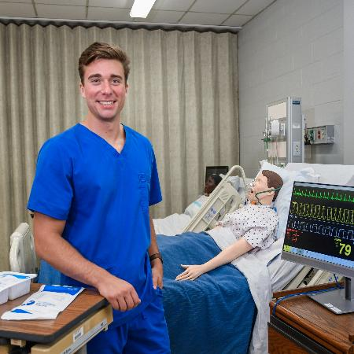



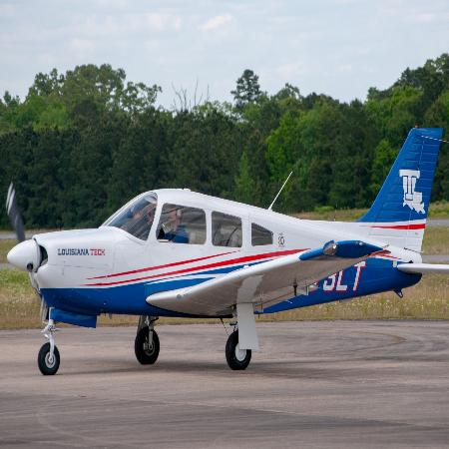

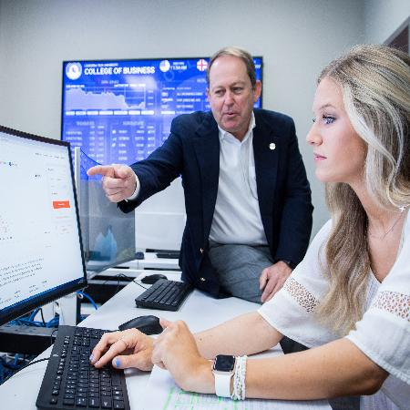



TECH’S FIVE COLLEGES

Slide 5
University Structure
Colleges
The largest hierarchy in the university’s academic structure. Includes the five colleges just mentioned: Applied and Natural Science, Business, Education & Human Sciences, Engineering & Science, and Liberal Arts.
Schools & Divisions
The middle hierarchy consisting of a collection closely-related majors and programs. Includes the Divisions of Nursing and Performing Arts and the Schools of Agricultural Sciences and Forestry, Accountancy, Design, and others.
Departments
A typically smaller academic unit such as the Departments of Kinesiology, Psychology and Behavioral Sciences, Economics and Finance, and others.

Slide 6
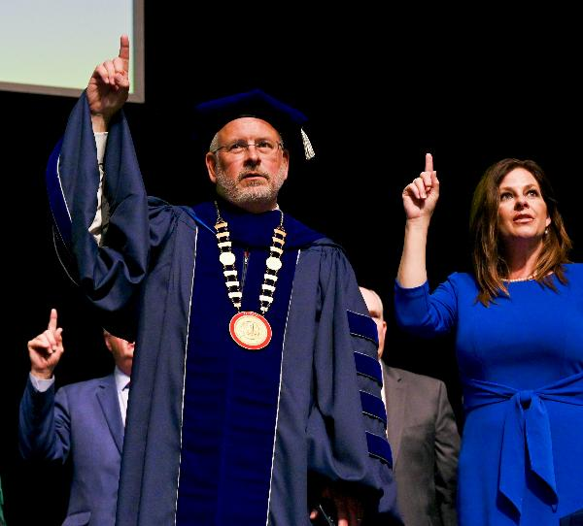
So who is in charge?
Within the university as well as each individual academic college there are several levels of leadership overseeing the daily operations of Louisiana Tech.

Slide 7
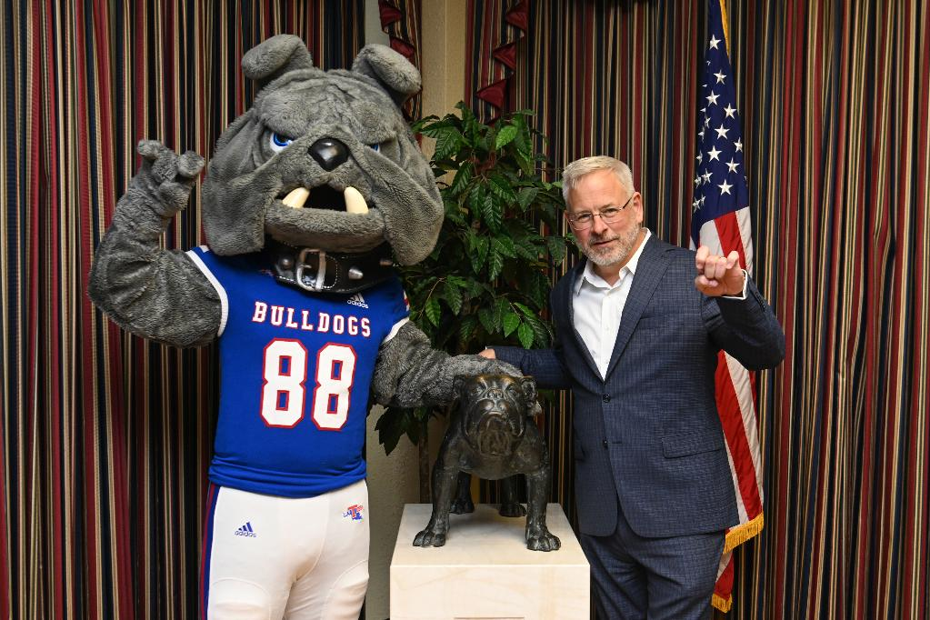
UNIVERSITY PRESIDENT
Dr. Jim Henderson

Slide 8
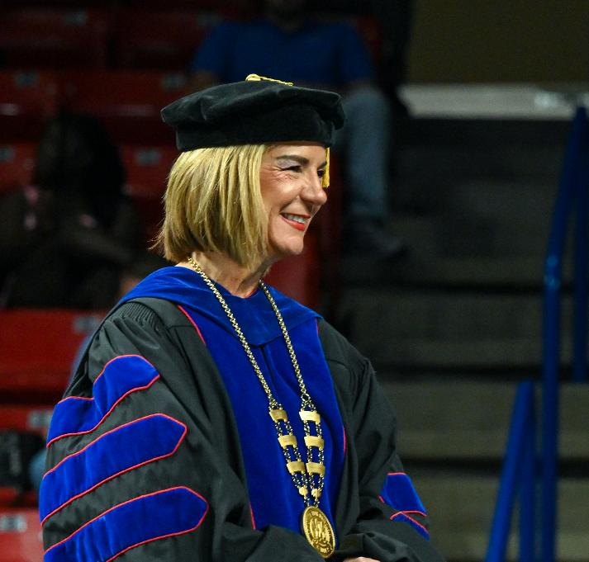
UNIVERSITY PROVOST The Chief Academic Officer of Louisiana Tech
Dr. Donna Thomas

Slide 9
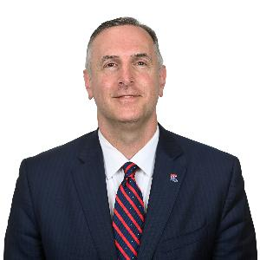
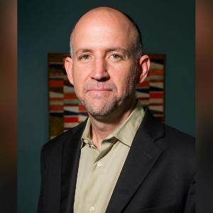
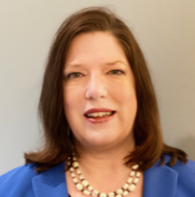
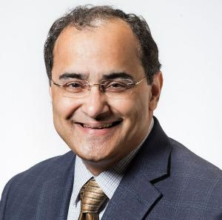

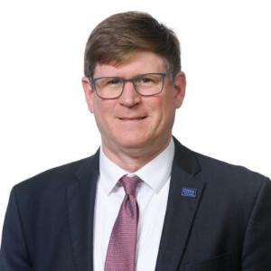
THE VICE PRESIDENTS
Dr. Dickie Crawford
VP of Student Advancement
Dr. Davy Norris
VP of Innovation & Advancement
Lisa Bradley
Assistant VP and CFO
Dr. Ramu Ramachandran
Associate VP of Research
Cami Geisman
VP of External Affairs
Dr. Tom Hoover
Chief Information Officer

Slide 10
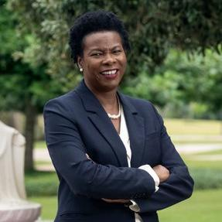
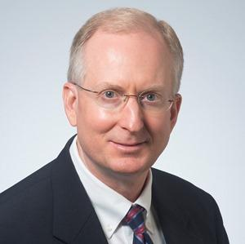



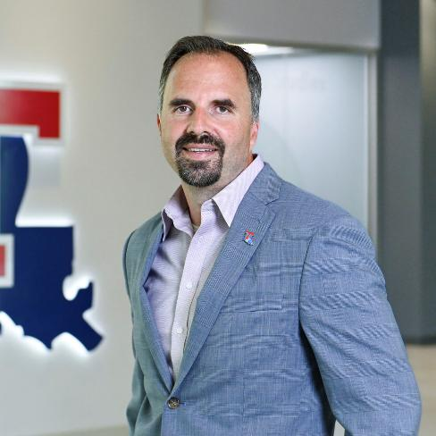
COLLEGE DEANS
Dr. Gary Kennedy
Dr. Henrietta Pichon
Mr. Karl Puljak
Dr. Chris Martin
Dr. Colin Wick

Slide 11
UNIVERSITY POLICIES
Attendance Policy: It’s not “optional”
Regardless of what you may have heard, attendance is not optional in college. While it is true that attendance policies may vary by class, it is best practice to attend class regularly in order to get all the notes, take any surprise quizzes, review for tests, and more.
Academic Standing
Your academic standing is determined by your grade point average (GPA) on all hours that you have attempted (including dual enrollment and transfer credit). There are three levels:
Good Academic Standing (above a 2.0 GPA), Academic Probation (below a 2.0 cumulative GPA), and Academic Suspension (below a 2.0 cumulative & quarterly GPA for consecutive quarters).
Academic Honor Code and Classroom Behavior Policy
The purpose of the Honor Code is to articulate and support the maintaining of the highest standard of conduct in academic affairs by educating students about and preventing; cheating, falsification, and stealing/unauthorized access of materials. The Classroom Behavior Policy is designed to set clear guidelines for students and instructors to promote an intellectually stimulating experience and respectful environment while minimizing disruptive behavior.

Slide 12
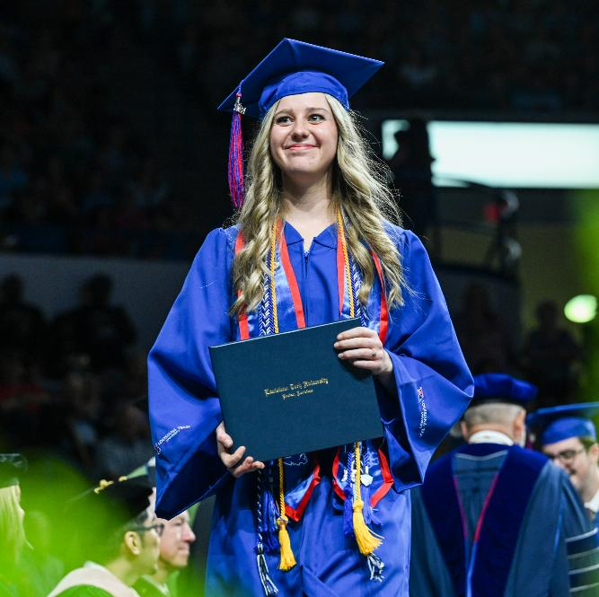
ACADEMIC PROGRAMS
BACHELORS DEGREE
The highest level of an undergraduate degree. Includes Bachelor’s of Arts, Fine Arts, Interior Design, Science, Arts in Architectural Studies, Science in Forestry, and Interdisciplinary Studies.
ASSOCIATES DEGREE
A degree typically awarded after a minimum of two years of study. Tech offers an Associates degree in General Studies (through the Barksdale Campus) and in Nursing (main campus).
MAJOR
The specific area of study that a student specializes in. Students can declare multiple majors at a time. Additional majors require more hours to be earned in addition to your primary major’s curriculum requirements.
MINORS
A secondary area of specialization beyond a college major. Requires an additional 21 hours of college credit.
CERTIFICATE
A shortened program that concentrates on a specific field of expertise rather than an entire course of study.
GRADUATE DEGREES
Continuation of study that can take the shape of a Masters or Doctoral Degree.

Slide 13
CALCULATING GPA
Add total number of hours completed total quality points. Quality points are equal to the number of credits hours for a course multiplied by the grade earned (A=4; B=3; C=2; D=1; and F=0)
COURSE | Hours | Grade (Points) | Quality Points (Hrs. x Points)
HIST 201 | 3 hrs. | B (3 pts.) | 3 hrs. x 3 pts. = 9
ENGL 101 | 3 hrs. | A (4 pts.) | 3 hrs. x 4 pts. = 12
BISC 130 | 3 hrs. | C (2 pts.) | 3 hrs. x 2 pts. = 6
BISC 131 | 1 hrs. | A (4 pts.) | 1 hr. x 4 pts. = 4
TOTAL | 10 hrs. | - | 9 + 12 + 6 + 4 = 31 pts.
To determine GPA, divide the total quality points for all earned hours by the total number of hours completed.
31 Points / 10 Hours = 3.1 GPA

Slide 14
CALCULATING GPA
Courses that are dropped with a “W” (before the drop date) do not count towards your grade point average.
Courses that give grades of satisfactory (“S”) or No Credit (“NC”) also do not count towards your grade point average.
Incomplete (“I”) grades are given in instances where a student has failed to complete all assigned class work and/or exams as a result of conditions beyond the student’s control. Incompletes must be requested by the student, and an “I” grade will be given to reflect the student’s current grade at the completion of the quarter. For example if a student earned a “C” without submitting all work, then they will receive an “IC”. Once incomplete work has been submitted, a student’s “I” will be replaced with the updated earned grade. “I” grades are counted towards GPA.

Slide 15
UTILIZING ACADEMIC RESOURCES
Chapter 7

Slide 16
CHAPTER OBJECTIVES
Identify academic services and resources provided across campus.
Articulate a plan for seeking assistance using campus resources.

Slide 17
What academic resources do you know about?
Have you used any of them yourself?

Slide 18
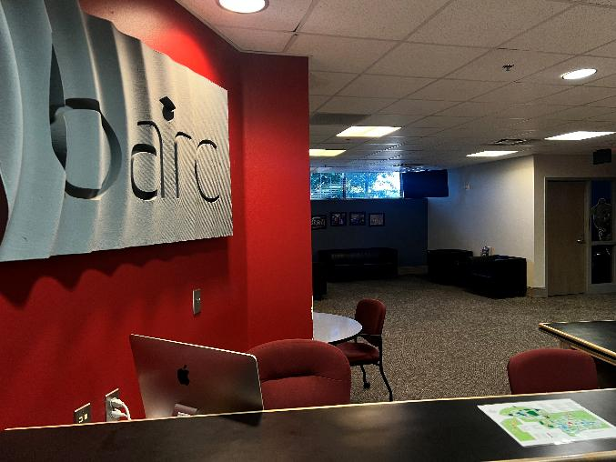
BULLDOG ACHIEVEMENT RESOURCE CENTER “The BARC”
WHERE IS IT?
Wyly Tower Main Floor – Room 202
WHAT SERVICES ARE OFFERED?
Tutoring (Chemistry, Math, Physics, and Statistics) – Room 226
Writing Assistance – Room 325
Campus Resource Referrals
Academic Advising Assistance
First-Year Experience (FYE) Program
Residential Life Offices
New Student Orientation

Slide 19
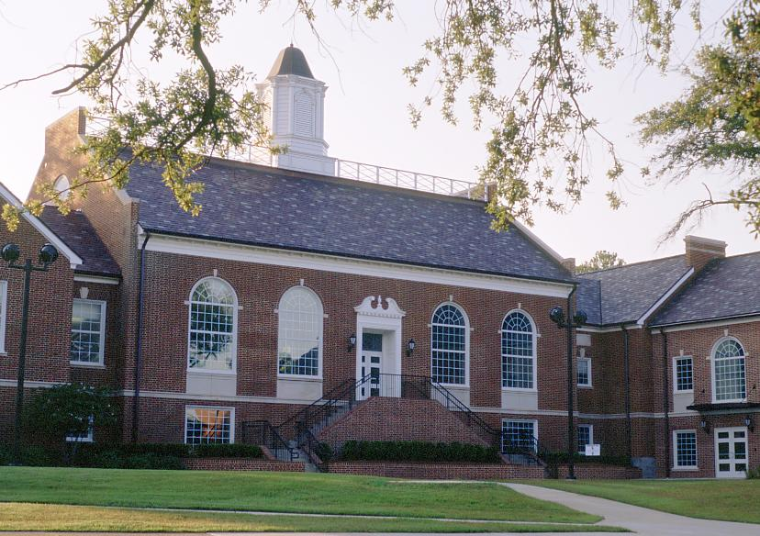

THE HONORS COLLEGE
WHERE IS IT?
University Hall – honors@latech.edu
WHAT IS IT?
Selective program that provides students with an elevated college experience. Includes a 21-credit hour curriculum threaded with an e-portfolio that students develop themselves.
HONORS PROGRAM BENEFITS:
Honors College distinction at graduation and on transcript.
Smaller than average class sizes
Priority registration for classes
Specialized honors advising
Opportunity to live in designated honors housing
Access to honors cultural, social, and academic events.

Slide 20
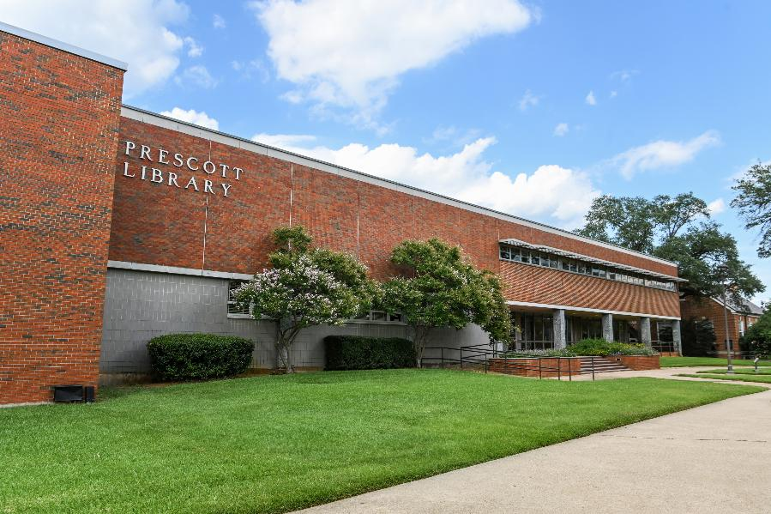
LIBRARY SERVICES
WHERE IS IT?
Prescott Memorial Library
WHAT SERVICES ARE OFFERED?
Research Service Librarians to help with research projects
Access to over three million books, e-books, journals, magazines, newspapers, government documents, and more.
One of 46 regional Government Document Depositories
Special Collections, Manuscripts, & Archives
Individual and Group Study Seating
Laptop Rentals
Computer & Print Lab

Slide 21
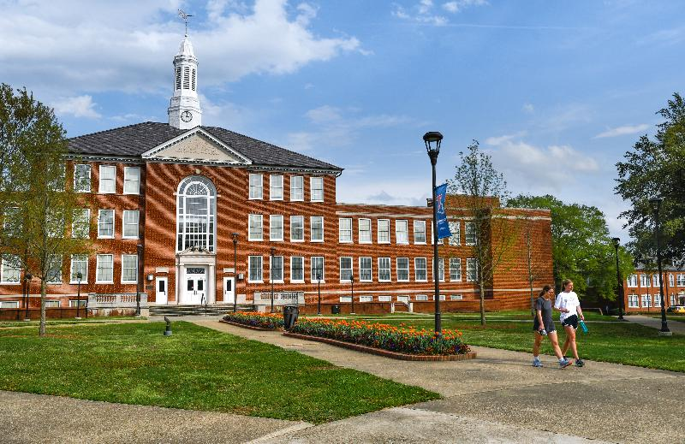
THE REGISTRAR’S OFFICE
WHERE IS IT?
Keeny Hall 207 – registrar@latech.edu
WHAT SERVICES ARE OFFERED?
The Registrar’s Office maintains academic records and:
Enrollment Verification (Insurance Discount, Scholarships, etc.)
Major Changes
Emergency Notification System
Graduation Coordination
Grade Collection
Resignation from the University
Maintaining the Academic Calendar
Transcript Services

Slide 22
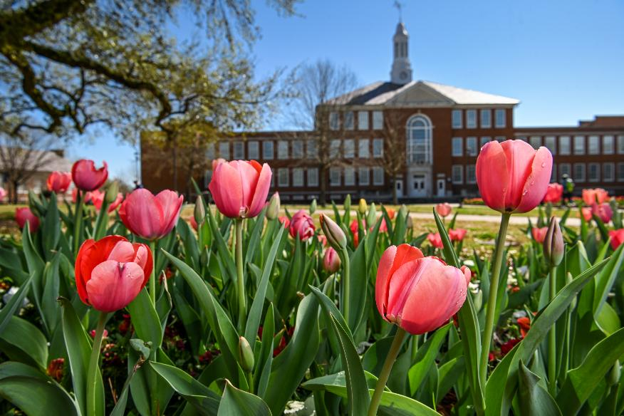
FINANCIAL AID OFFICE
WHERE IS IT?
Keeny Hall 237 – techaid@latech.edu
WHAT IS THEIR PURPOSE?
Assists with the process of obtaining financial assistance to offset the cost of attending the university.
WHAT SERVICES ARE OFFERED?
Information and Assistance with FAFSA and TOPS
Guidance on University Scholarship Opportunities
Academic Works Scholarship Portal
On-Campus Student Employment through Federal Work Study Program

Slide 23
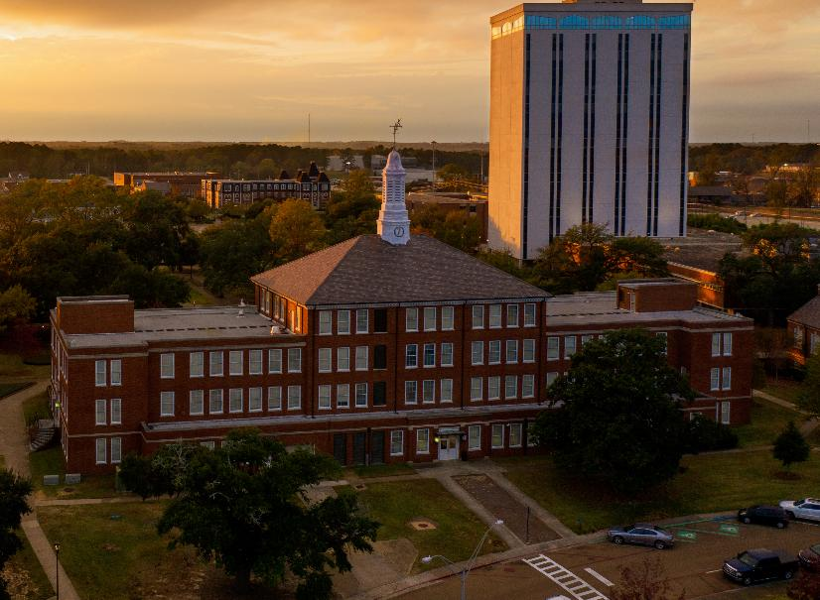
THE COMPTROLLER’S OFFICE
WHERE IS IT?
Keeny Hall 103 – cashier@latech.edu
WHAT IS THEIR PURPOSE?
Home of many of the financial activities of the campus including accounts receivable & payable, payroll, and accounting.
WHAT SERVICES ARE OFFERED?
Tuition & Fees Collection
Refund Checks & Electronic Deposits
Tech Express (more on next slide)
Travel Reimbursements

Slide 24

THE TECH EXPRESS OFFICE
WHERE IS IT?
Keeny Hall – 1st Floor (Cashier’s Office)– express@latech.edu
WHAT IS THEIR PURPOSE?
Distributes and manages Student ID cards and related functions.
HOW CAN THEY HELP ME?
Make and replace University ID Cards
Assist with managing your Dining Meal Plans
Helps set up and manage your Tech Express Account
Tech Express can be used across campus at ALL on campus dining locations, the bookstore, and various vending machines.
Can also be used off-campus at certain locations including; Dairy Queen, Newk’s Eatery, Flying Burger and Seafood, Smoothie King, and MORE!!

Slide 25
What’s Holding You Back? (Activity 7.2)
What concerns or challenges do you have about being a college student? What is keeping you from seeking the assistance from the resources mentioned in this chapter? How can you overcome this resistance?

